Slide 1

Combinational Logic
Chapter 4
Imran Siddiqi
imran.siddiqi@mcs.edu.pk
Computer Science Department
College of Telecommunication Engineering
National University of Sciences and Technology

Slide 2
Contents
Decoders
Demultiplexer
Implementing Functions with Decoders

Slide 3
Decoders
A decoder is a combinational circuit that converts binary information from n input lines to a 2^{n} unique output lines
Decoder
Combinational Logic Circuit
n Inputs
2^{n} Outputs

Slide 4
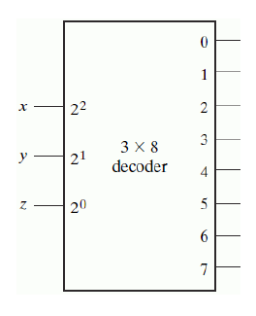
Decoders
A decoder selects one output based on binary input
Converts n-bit code into 2^{n} outputs, only one being active for any combination of inputs
Selects output x if input is binary representation of x
Also called n-to-m line decoders for example:
  2-to-4 line decoder
  3-to-8 line decoder

Slide 5
Decoders
Selection of any kind
  Microprocessor memory system: selecting different banks of memory.
  Microprocessor I/O: Selecting different devices.
Implementing arbitrary logic functions

Slide 6
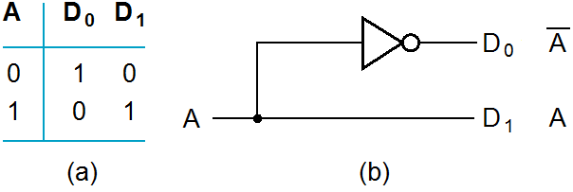
Decoder Examples
1-to-2-line Decoder

Slide 7
Decoder Examples
2-to-4-Line Decoder
A
0
A
1
A
0
D
0
D
1
D
2
D
3
A
1
0
0
1
0
0
0
D
A
A
0
1
0
1
0
0
0
1
0
1
0
0
0
1
0
1
1
0
0
0
1
D
1
A
1
A
0
(a)
D
2
A
1
A
0
D
3
A
1
A
0
(b)

Slide 8
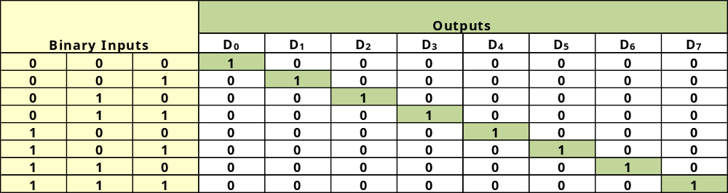
Decoder Examples
3-to-8-Line Decoder
Three inputs are decoded into eight outputs, each representing one of the minterms of the three input variable
If the input corresponds to minterm m_{i} then the decoder ouput_{i} will be the corresponding single output

Slide 9
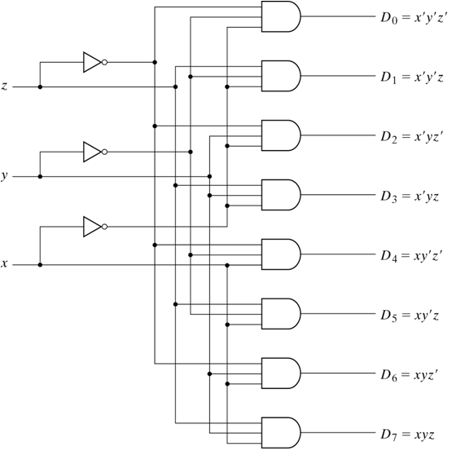
3-to-8-Line Decoder
When is output 0 chosen?
  If x’ y’ z’
When is output 1 chosen?
  If x’ y’ z
… and so on …

Slide 10
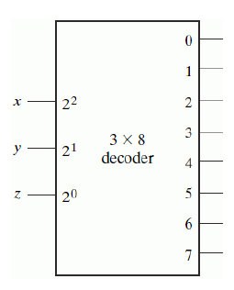
3-to-8-Line Decoder

Slide 11
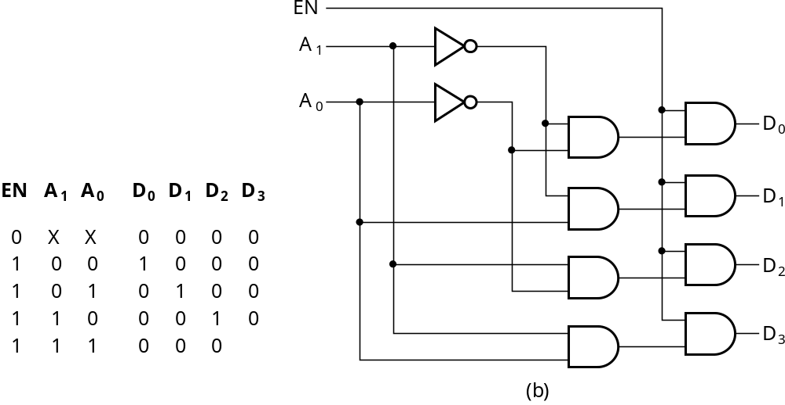
Decoder with Enable Input
The decoder is enabled when EN = 1. The output whose value = 1 represents the minterm is selected by inputs A and B.
The decoder is disabled when EN = 0→ D₀ … D₃ = 0

Slide 12
Decoder with Enable Input
A Decoder with enable input is called a demultiplexer.
Demultiplexer receives information from a single line and directs it to the output lines.

Slide 13
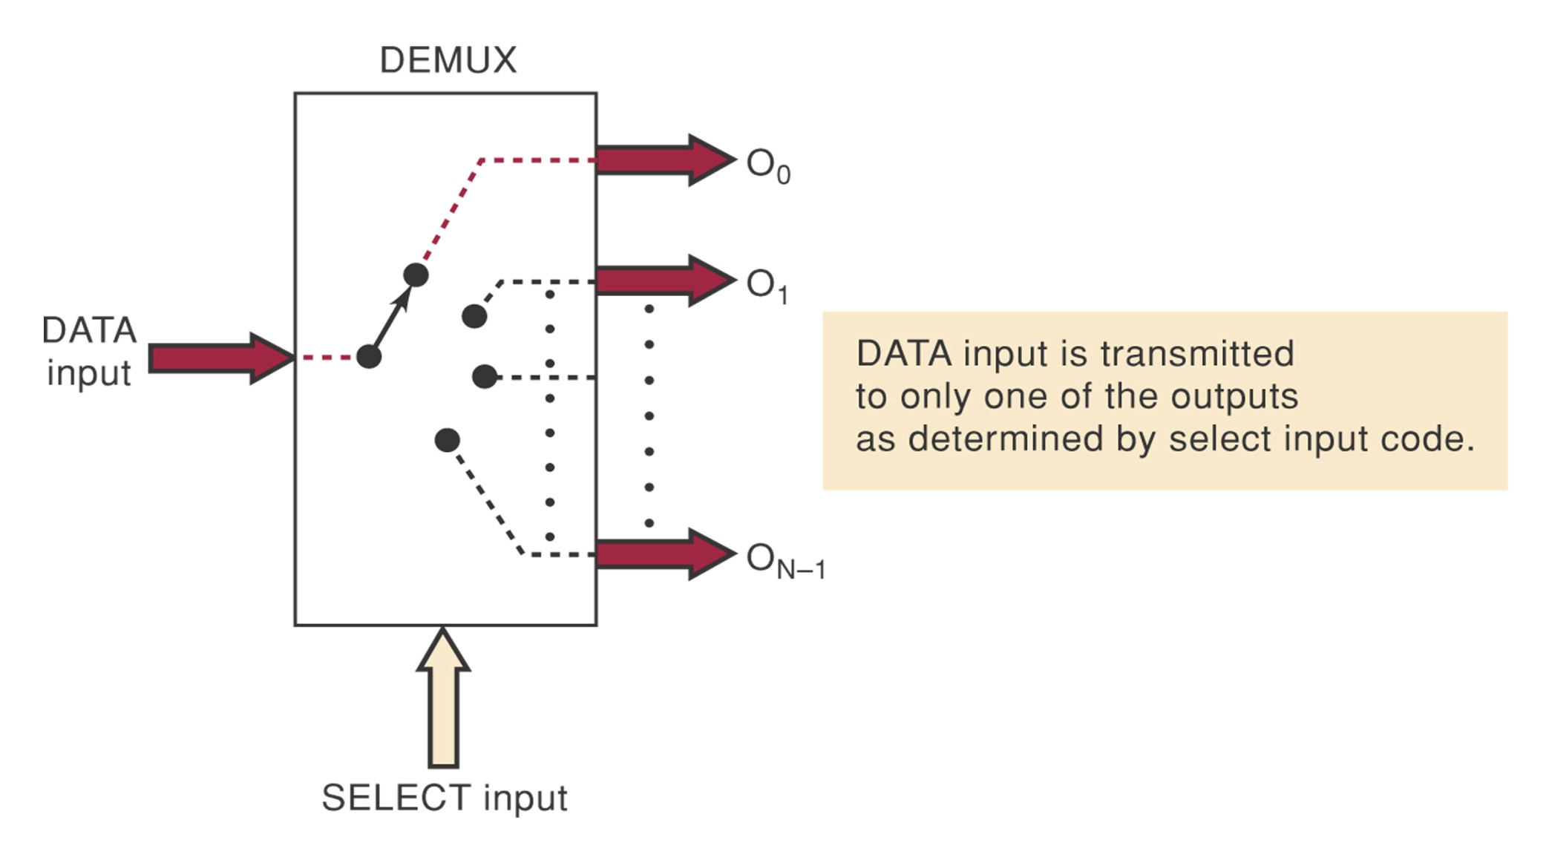
Demultiplexer

Slide 14
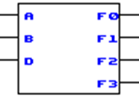
Demultiplexer
A demultiplexer “connects” a data input to one and only one output. The selected output is specified by a decoding of the control inputs.
D | A | B | F3 | F2 | F1 | F0
D | 0 | 0 | 0 | 0 | 0 | D
D | 0 | 1 | 0 | 0 | D | 0
D | 1 | 0 | 0 | D | 0 | 0
D | 1 | 1 | D | 0 | 0 | 0
DEMUX
Select
Lines
Outputs
Data
Input

Slide 15
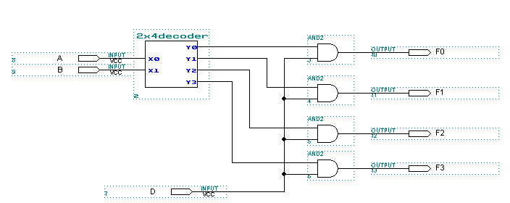
1 to 4 Demux
Only one
F will be
active
2x4 Decoder
Only 1 AND gate will
be “ON”

Slide 16
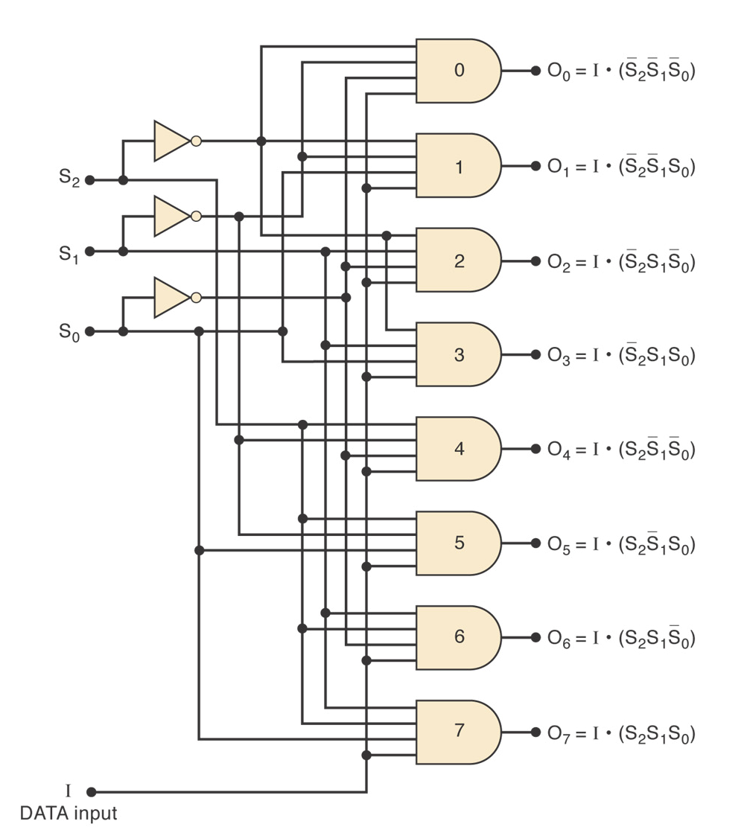
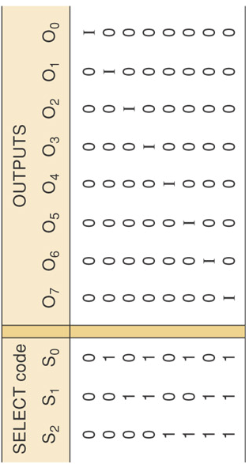
1-to-8 line DEMUX

Slide 17
Decoder with Enable
EN is called a Control Signal
Control Signals can be
  Active High Signal
    EN = 1 – Turns “ON” Decoder
  Active Low Signal
    EN=0 – Turns “ON” Decoder

Slide 18
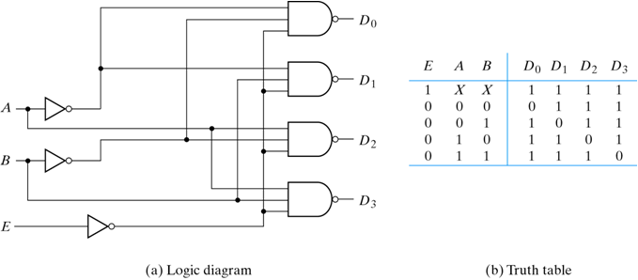
Decoder with Enable Input - NAND
2-to-4 line decoder with Enable - NAND implementation
Circuit generates output only if Enable is selected (E=0)
If disabled (E=1), no output line is picked
Truth table for NAND decoder
  Complemented outputs and Enable

Slide 19
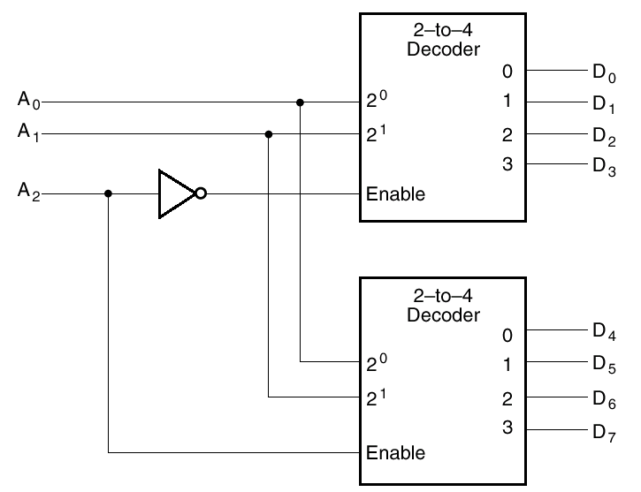
Using Enable Input for Expansion

Slide 20
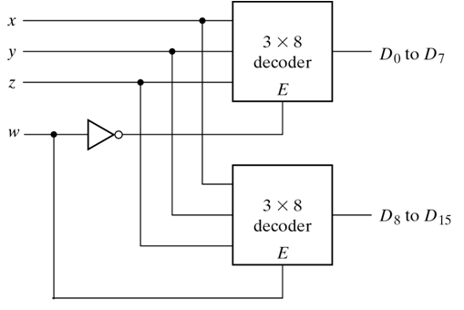
A 4x16 Decoder
When w = 1, the top decoder is disabled and the bottom is enabled.
Bottom decoder generates 8 minterms 1000 to 1111, while the top decoder outputs are 0’s.
When w = 0, the top decoder
is enabled and the bottom is disabled.
Top decoder generates 8 minterms 0000 to 0111, while the bottom decoder outputs are 0’s.

Slide 21
Implementing Functions with Decoders
Implement m functions of n variables with:
  Sum-of-minterms expressions
  One n-to-2^{n}-line decoder
  m OR gates, one for each output
Approach
  Find the minterms for each output function
  OR the minterms together

Slide 22
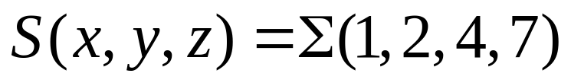
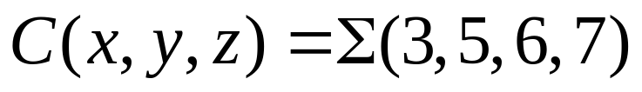
Example: Full Adder with Decoder
The sum and carry outputs of a full adder are given by:
A | B | C_{in} | S | C
0 | 0 | 0 | 0 | 0
0 | 0 | 1 | 1 | 0
0 | 1 | 0 | 1 | 0
0 | 1 | 1 | 0 | 1
1 | 0 | 0 | 1 | 0
1 | 0 | 1 | 0 | 1
1 | 1 | 0 | 0 | 1
1 | 1 | 1 | 1 | 1

Slide 23
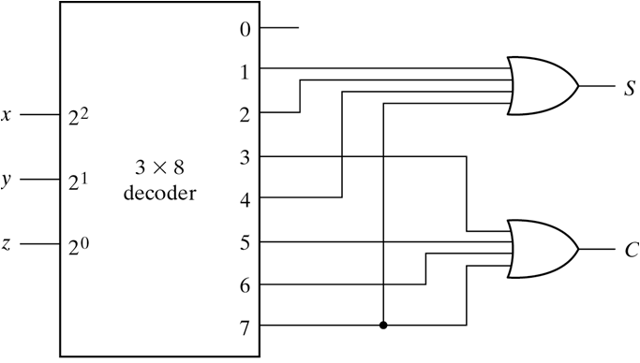
Example: Full Adder with Decoder

Slide 24
References
Chapter 4 – Digital Design Morris Mano
Logic and Computer Design Fundamentals, 4e, Power Point Slides, 2008 Pearson Education Inc.
Digital Design – Amirali Baniasadi
Material in these slides has been taken from, the following resources

